Slide 1
Analytics Dashboard
DATA
Using Azure Databricks & PySpark

Slide 2
Project Statement
Create a real-time analytics dashboard using Azure Databricks and PySpark. Ingest streaming data, process it with PySpark SQL, and visualize the results in real-time using Databricks notebooks or other visualization tools.

Slide 3
Project Requirement
Azure Databricks
PySpark
Azure EventHubs
Visualization tools
DataBricks Notebooks
Cloud-based platform for data processing and analytics.
Python API for distributed data processing.
Scalable event ingestion service for streaming data.
Libraries for creating interactive visualizations and dashboard.
Interactive environment for data exploration and analysis.

Slide 4
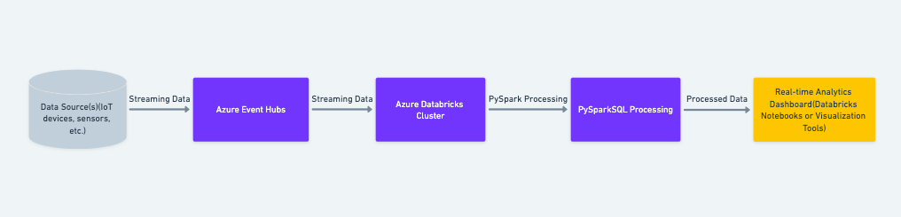
Architecture Diagram

Slide 5
Benefits of real time Dashboard
01
02
Immediate Insights
Decision Support
04
03
Agility And Scalability
Efficiency & Performance
Collaboration
05

Slide 6
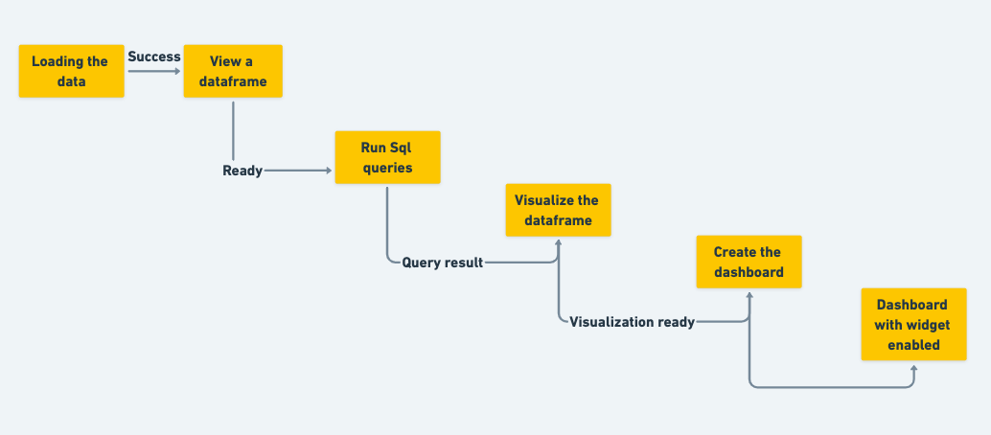
Process flow
This can be the part of the presentation where you introduce yourself, write your email…

Slide 7
implementation-
Data Ingestion:
Configure Azure Event Hubs for streaming data ingestion from various sources.
Set up event listeners to continuously ingest streaming data into Azure Databricks.
Data Processing with PySpark:
Utilize PySpark within Azure Databricks to process streaming data in real-time.
Define schemas for parsing and transforming streaming data.
Apply PySpark functions for filtering, aggregation, and enrichment.
Real-time Analytics Dashboard Development:
Develop interactive dashboards using Databricks Notebooks and visualization tools.
Implement live updates and streaming capabilities within the dashboard.

Slide 8
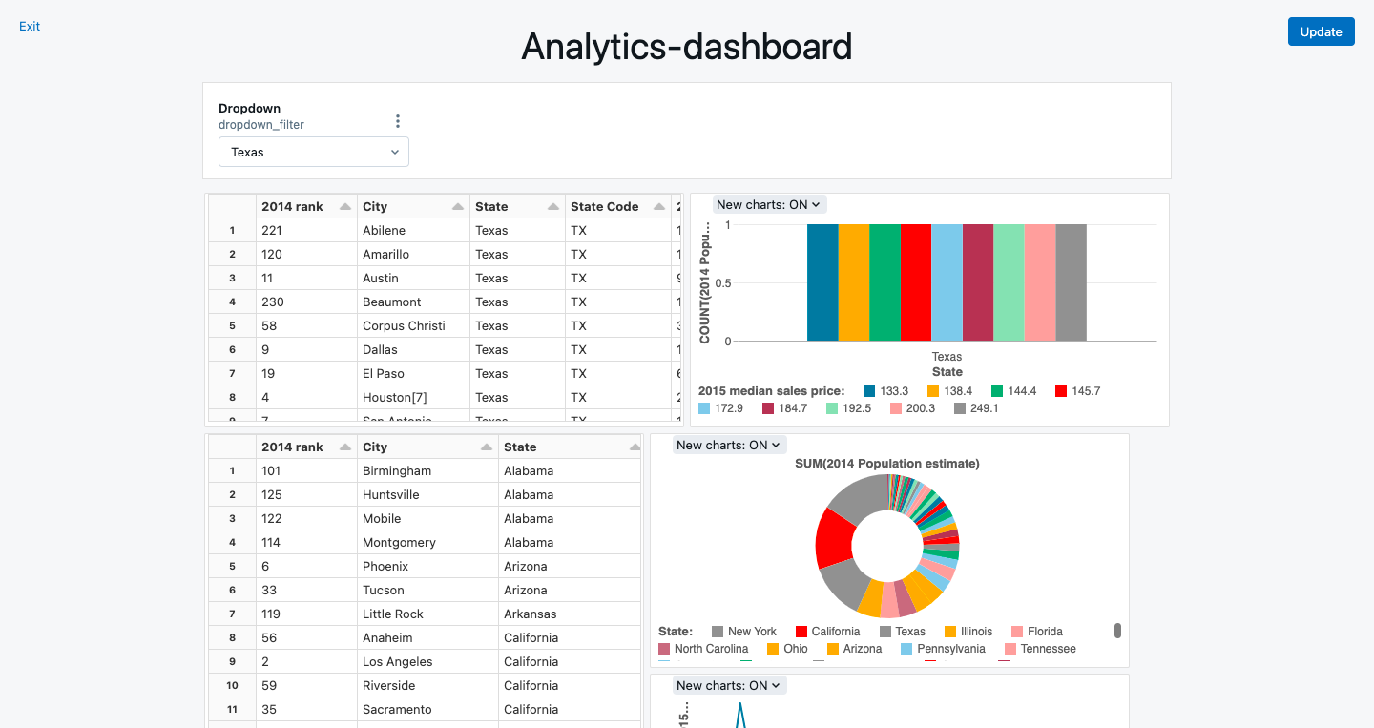
FInal Output

Slide 9
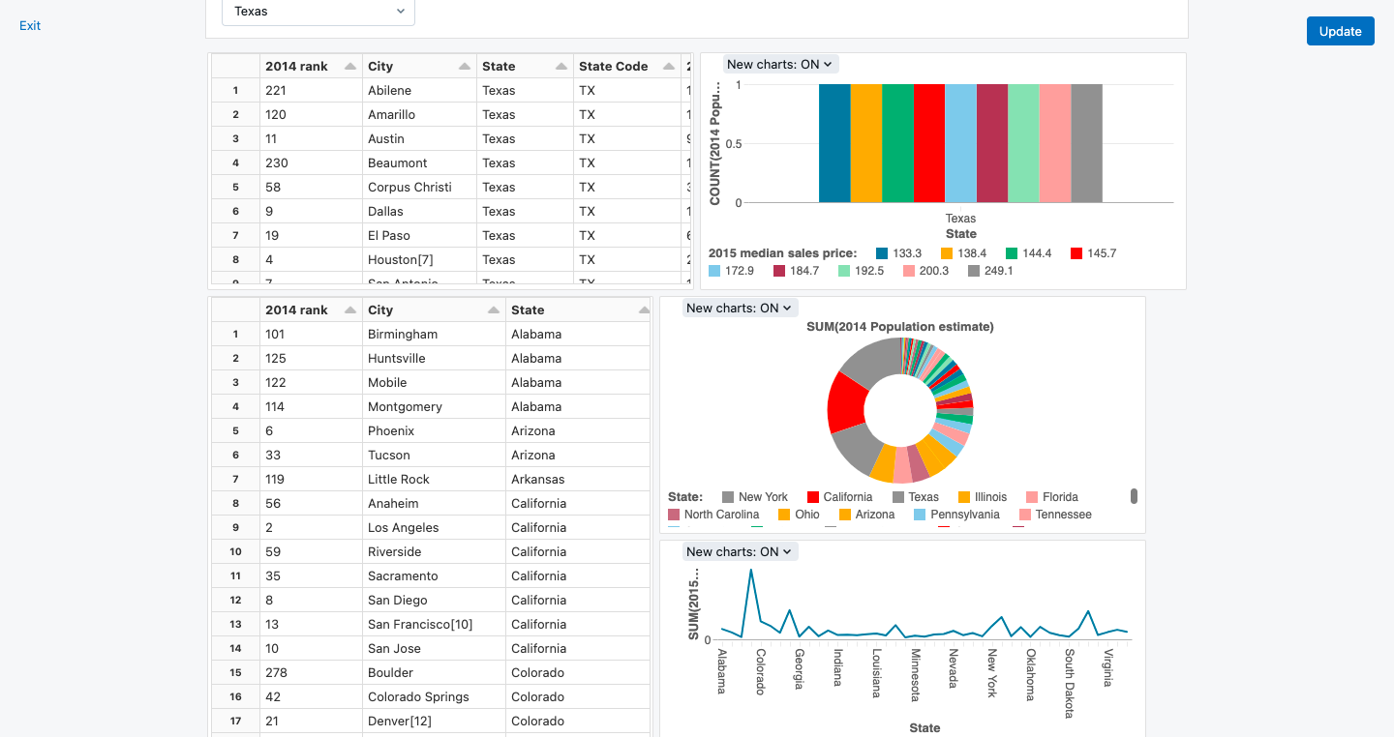
FInal Output

Slide 10
Thank YOu

